Slide 1
Group Members Syed Hashir Hussain 2021-CS-1
M. Kabir Ahmad 2021-CS-4
M. Hammad Hassan 2021-CS-33
Merchant Monetary System

Slide 2
Project Description
The system is designed for a company that provides:
Logistics (delivery of products to its client), product management(crud operations)
and effective communication with their employees and clients.
The company has its office, warehouse, and rider.
It has a different contract with multiple firms to take the shipment and store it in
dedicated warehouses. The rider will take orders from the shopkeeper. Their order
is received at the office, and the office will create the feasibility report according
to their client's needs and instructions generated for their warehouse manager to
fulfill their order. The available rider will receive an email about their order.
The office will send a confirmation email to their client.

Slide 3
Project Features
CEO are able to manage employee, warehouse manager, rider and shopkeeper.
CEO and Employee manage product related operations.
CEO will be able to analyze company operations.
Warehouse manager ready the shipment for rider.
Rider delivered the shipment to their shopkeeper.
Rider are able to selected the shortest route to reach the destination.
One user is able to notify other user through email.
Shopkeeper are able to view products and place order.
Dedicated security password for each user.
Company expenditure report will be generated.

Slide 4
Merchant Monetary System
Project Actors:
CEO: The owner of company could manage all the operations
Employee: They directly reported to CEO and help in company operations.
Warehouse Manager: Ready the shipment for rider and manage other expenses.
Rider: Received the detail of order and delivered the product to presubscribed routes.
Stakeholders:
Shopkeeper: Are able to outlook products, place order and check detail.

Slide 5
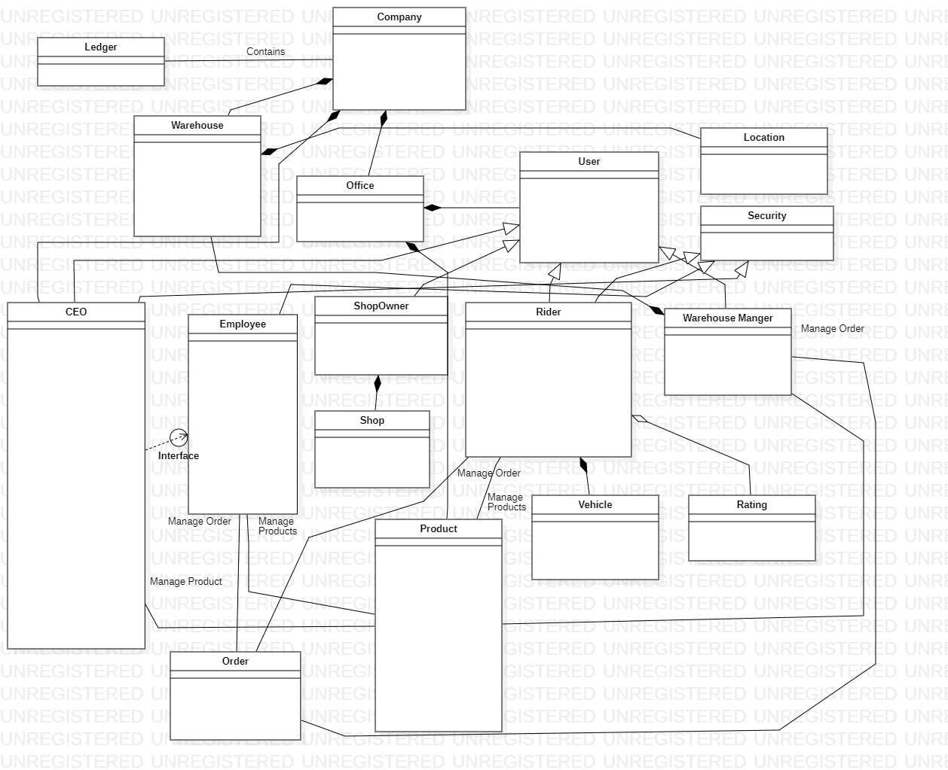
Merchant Monetary System
UML DAIGRAM OF THE PROJECT WITH OUT ATTRIBUTES AND FUNCTIONS

Slide 6
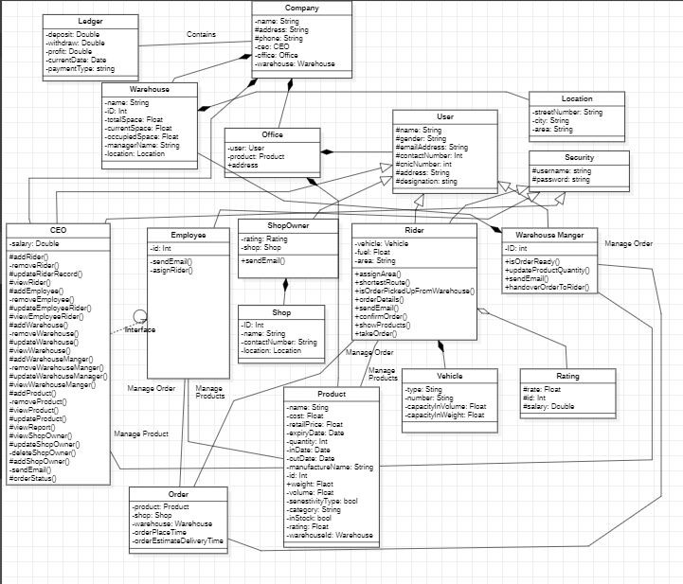
Merchant Monetary System
UML DAIGRAM OF THE PROJECT

Slide 7
Merchant Monetary System
Data Structures Used in the project:
Linked List
Stack
Queue
Binary Search Tree

Slide 8
Merchant Monetary System
Object Oriented Features used in the project:
Inheritance
Composition
Aggregation
Association
Interface
Multilevel Inheritance

Slide 9
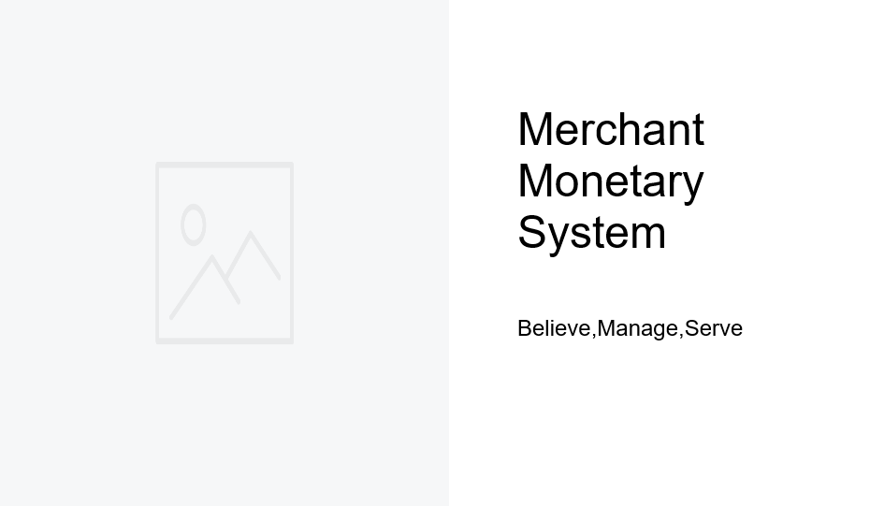
Merchant Monetary System​
​
​
User Interfaces

Slide 10
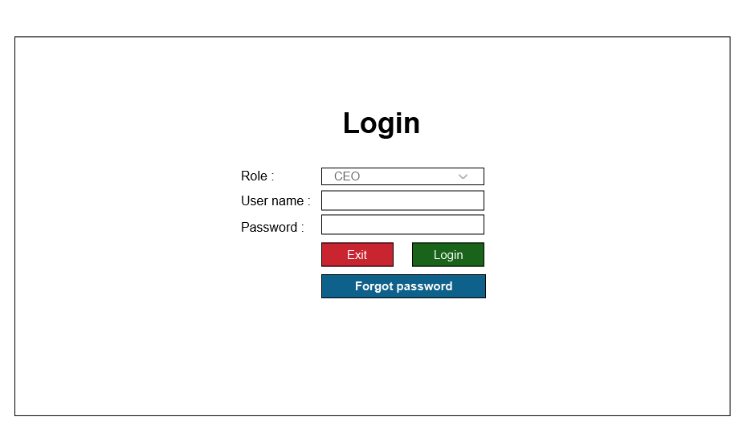
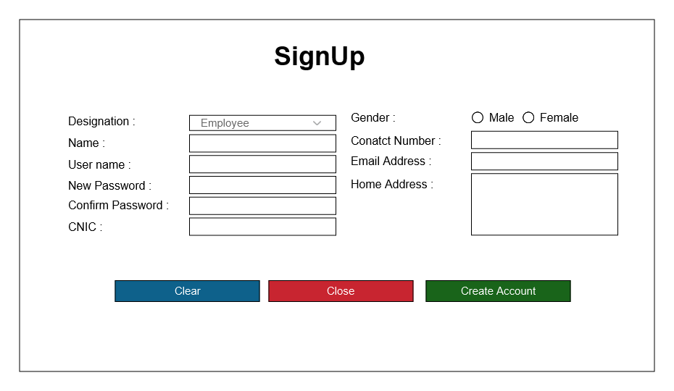
Merchant Monetary System
USER INTERFACES –LOGIN AND SIGN UP PAGE

Slide 11
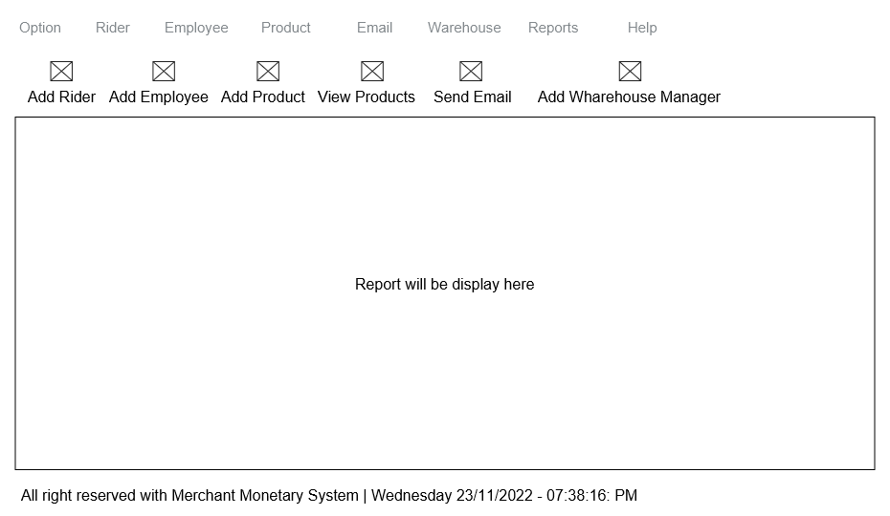
Merchant Monetary System
USER INTERFACES –PAGE CEO DASH BOARD PAGE

Slide 12
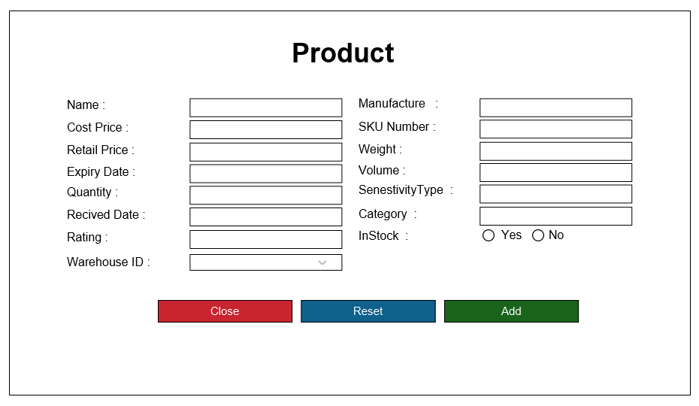
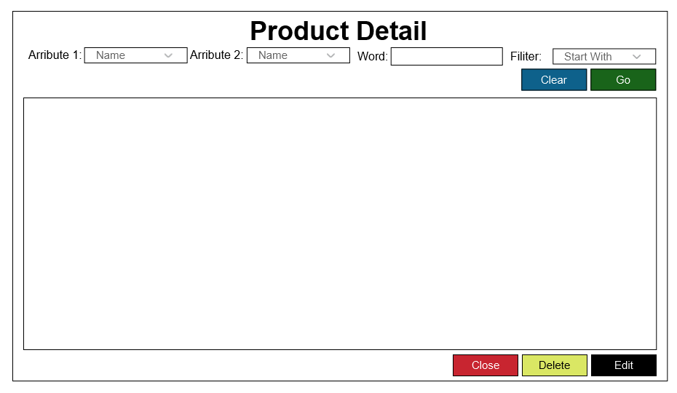
Merchant Monetary System
USER INTERFACES – ADD PRODUCT AND VIEW PRODUTS PAGE

Slide 13
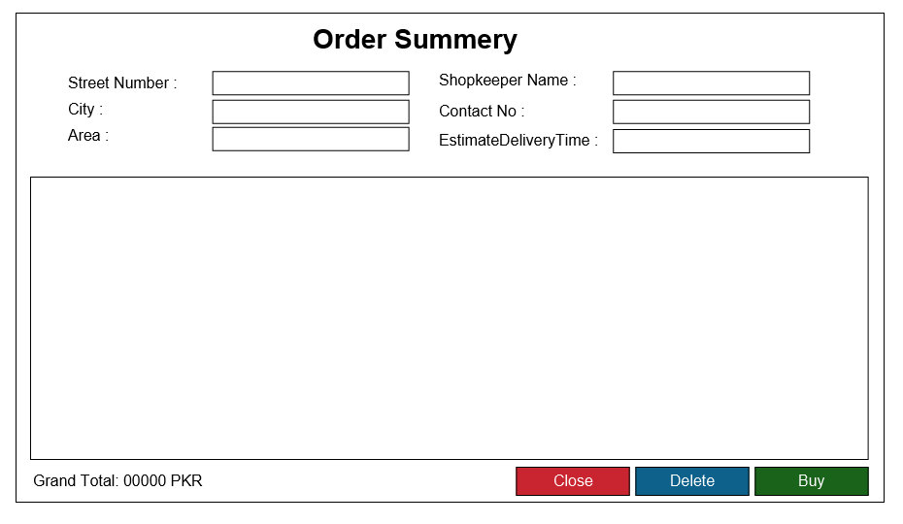
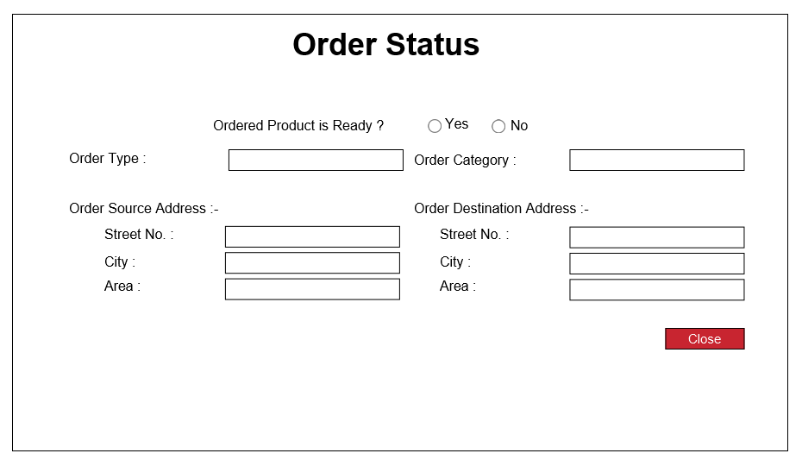
Merchant Monetary System
USER INTERFACES – ORDER SUMMARY AND ORDER STATUS PAGE

Slide 14
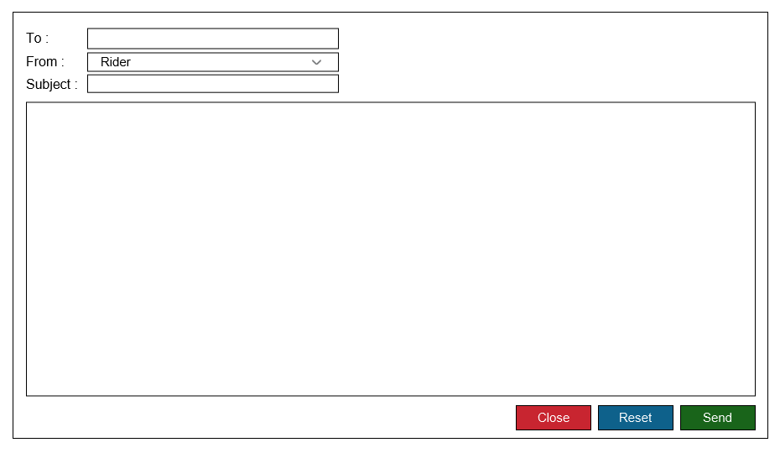
Merchant Monetary System
USER INTERFACES –EMAIL SENDING PAGE

Slide 15
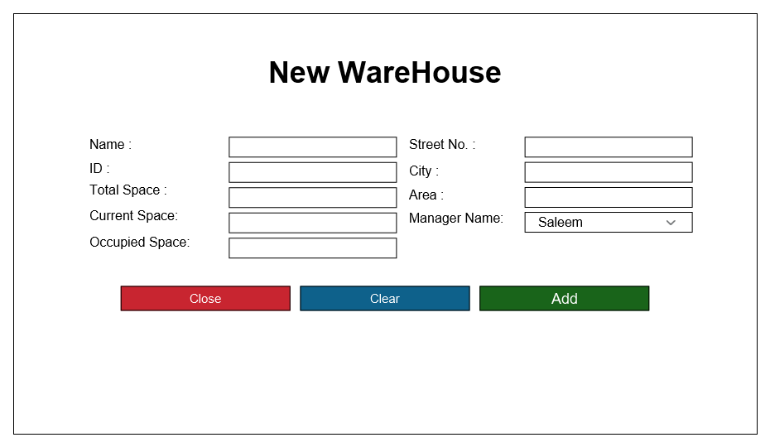
Merchant Monetary System
USER INTERFACES –ADD WAREHOUSE PAGE

Slide 16
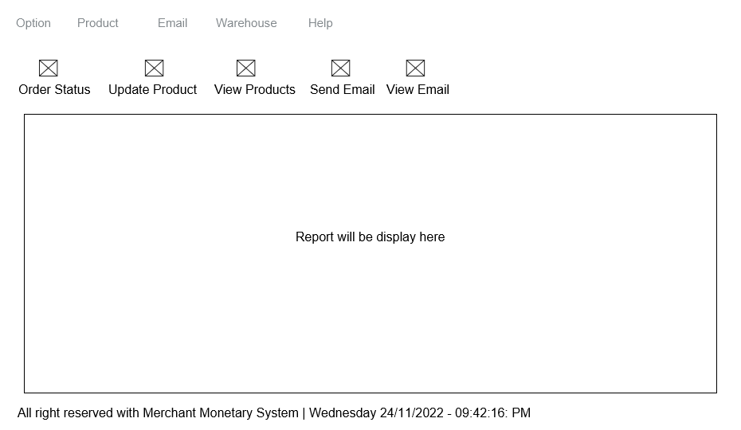
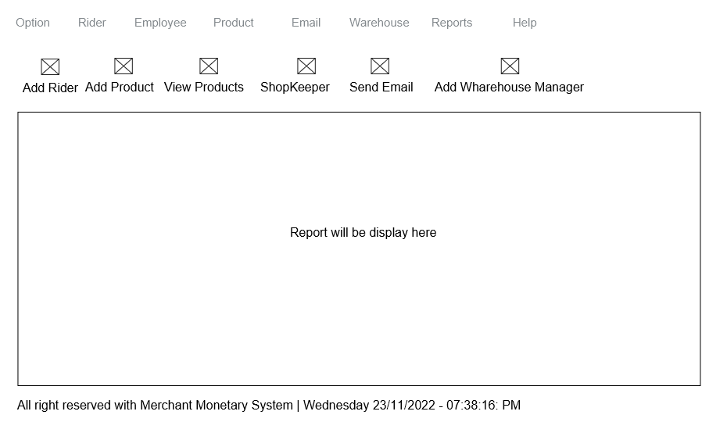
Merchant Monetary System
USER INTERFACES –WAREHOUSE MANAGER AND EMPLOYEE DASHBOARD PAGES

Slide 17
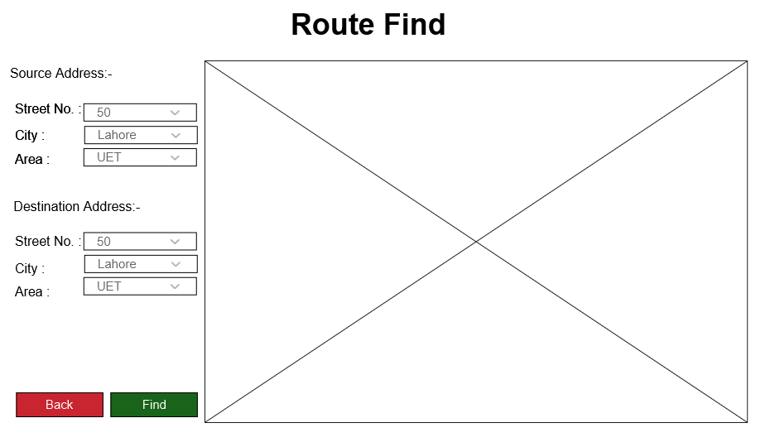
Merchant Monetary System
USER INTERFACES –ROUTE FINDER PAGE

Slide 18
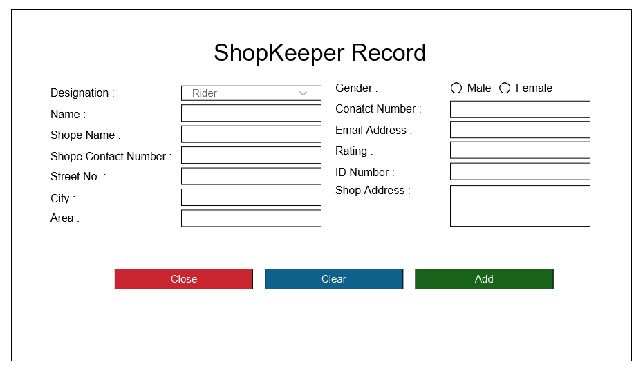
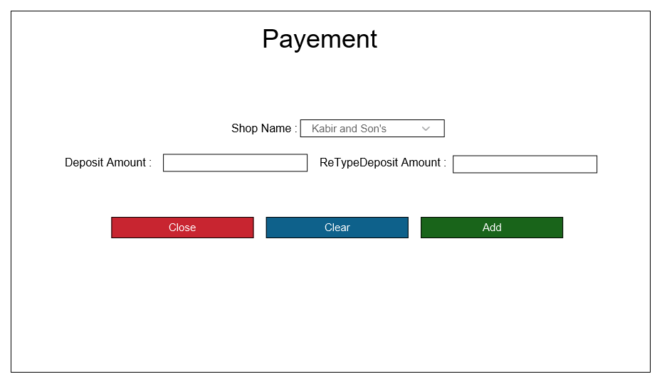
Merchant Monetary System
USER INTERFACES –ADD SHOP KEEPER AND ADD PAYMENT PAGE

Slide 19
Merchant Monetary System
Data Storage
Mails (CSV)
Products (CSV)
Users (CSV)

Slide 20
Merchant Monetary System
Email Sending
Rider will email the employee about the order of shopkeeper
Employee email warehouse manager to ready the shipment for rider
Rider will email the Employee and Shopkeeper that he has picked the order and cc to CEO.

Slide 21
Merchant Monetary System
Analytical Reports
Salary Report
Rider Capture Order Report
Profit Report
Sold Products

Slide 22
Merchant Monetary System
Project Plan
Use Case Id | Member Name | Estimated Completion Date
001-008 | Syed Hashir Hussain | 09/12/2022
009-018 | Kabir Ahmed | 10/12/2022
019-026 | M. Hamad Hassan | 11/12/2022

